Slide 1
Topic: Apply Relative Decimals EQ: How do you round and estimate with decimals?
Year 11 Essentials

Slide 2
Things Required For This Lesson
Interactive Notebook
Textbook: Interleaved Maths Essential Connections
Ruler, Red Pen, Pencil, Pens, Scientific Calculator
Growth mindset

Slide 3

24
7
30
Topic: Relative Size of Negative Numbers
Date: 12/02/2021
EQ: How do you use known and unknown information to find perimeter?
WICOR
This Photo by Unknown Author is licensed under CC BY-SA

Slide 4

Interleave Questions set 2 Q7 -9
COPY AND SOLVE – UNDERLINE KEY WORDS
If the Australian Population is 25.18 million (2018), roughly fraction or percentage lived in QLD – 5,052,800.
According to the ABS, Australia's population grows by 1.6% every year. With this information and from the above question, what will the 2019 population be?
The time is 2:45pm. I start work at 5:20pm. How long until I start work?
If I earn $21 an hour and I work 30 hours, what is my gross pay that week?
If I am taxed at 10% tax for question 4, how much would my net pay be?
Gross pay – Total amount pre tax Net pay – Total amount after tax

Slide 5
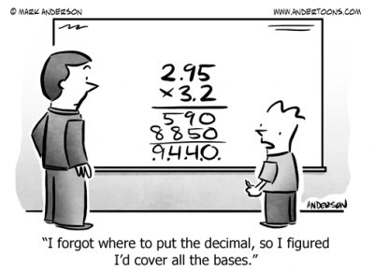
Origin of the word Decimal
Decimal (n.)
Deci is Latin for ‘tenth’
Decimal numbers are therefore “Base Ten”, So we can use it to understand converting fractions to decimals.
Copy into your books

Slide 6
Decimals
Draw a Numberline 0-1
Consider what decimal number is close to the amount you are given and what fraction is roughly the same. Mark them on your line and explain how you worked out where each should be placed.
1. 0.496 Close to: Nearby fraction:
2. 0.102 Close to: Nearby fraction
3. 0.253 Close to: Nearby fraction:
4. 0.989 Close to: Nearby fraction:
5. 0.81 Close to: : Nearby fraction:
Notes:
Have post-it notes pre-prepared with -50, 25, 0, -75, 50, 75 for whole class display on the board

Slide 7
Decimals
When converting between measurements it is helpful to think about whether you need more or less. For example, consider 1m.
There are more cm in a m, because cm are smaller so more fit into the same space.
That means that after converting from metres into to centimeters, you should have a larger number. m to cm: you should have more
1m = 1 (sets of 100) = 100cm 2m = 2 (sets of 100) = 200cm cm to m: you should have less 500cm = 500 (split into sets of 100) = 5m 250cm = 250 (split into sets of 100) = 2.5m
Notes:
Have post-it notes pre-prepared with -50, 25, 0, -75, 50, 75 for whole class display on the board

Slide 8
Decimals
Set B: Ordering and comparing lengths Compare the following sets of measurements. Use the box on the right to help you to convert them into metres so that you can compare them. Rewrite each set in ascending order (smallest to largest), including explaining if any numbers are equal.
6. 0.5m, 0.50m, 0.05m
7. 49mm, 4.9m, 49cm
8. 2.5cm, 250mm, 0.0025m
9. 0.5m, 5cm, 0.50cm
Notes:
Have post-it notes pre-prepared with -50, 25, 0, -75, 50, 75 for whole class display on the board

Slide 9
Decimals
Ordering – More practice
Write these numbers in order of size. Start with the smallest number.
1. 0.92, 0.901,0.99, 0.099, 0.909
2. 4.2, 0.42, 0.024, 0.93, 0.039
3. Five boys take part in a long jump competition. The distances jumped were: 4.31m, 4.08m, 4.1m, 4.093m, 4.51m
(a) Write down the distance of the longest jump
(b) Put the jumps in order, starting with the shortest.
Notes:
Have post-it notes pre-prepared with -50, 25, 0, -75, 50, 75 for whole class display on the board

Slide 10
Decimals
Set C: Rounding decimal numbers In Set A above you considered what decimal number was close to the one you were given.
This is an informal way of rounding. When we are rounding numbers, we consider which number on either side is closest to our amount.
For example, if rounding 0.463 to the nearest one we would consider if it was closer to 0 or 1; if rounding it to the nearest tenth we would consider if it was closer to 0.4 or 0.5; if rounding it to the nearest hundredth we would consider if it was closer to 0.46 or 0.47.
What’s the important number when it comes to rounding? When you decide if you round up or down.
Notes:
Have post-it notes pre-prepared with -50, 25, 0, -75, 50, 75 for whole class display on the board

Slide 11
Decimals
Complete the table to round the following numbers.
Original Number | Nearest one | Nearest tenth | Nearest hundredth
0.463
0.555
0.494
0.209
Notes:
Have post-it notes pre-prepared with -50, 25, 0, -75, 50, 75 for whole class display on the board

Slide 12
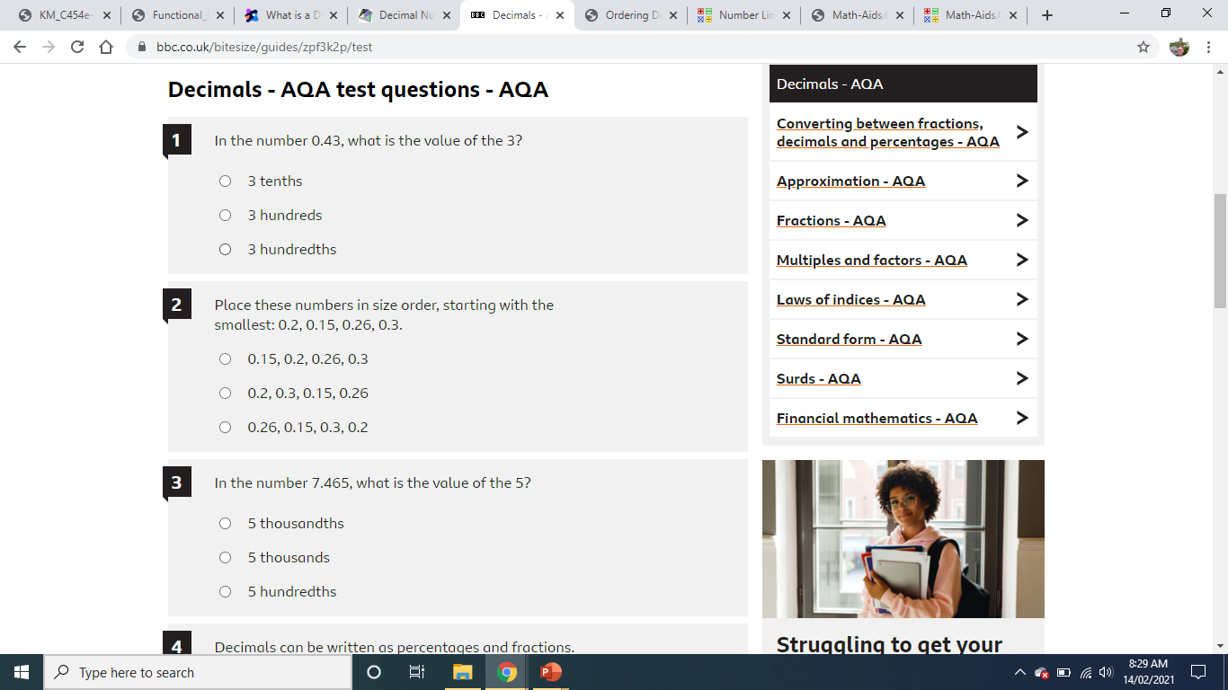
Notes:
Review understanding of equations.
Use CUBES strategy to break down question.
Circle the numbers
Underline the question
Box math keywords
Eliminate unnecessary information
Solve and check whether your answer is reasonable

Slide 13

Thank you
Keep up the good work!
Quote of the day –
IF YOU ALWAYS DO WHAT YOU’VE ALWAYS DONE, YOU’LL ALWAYS GET WHAT YOU’VE ALWAYS GOT

